Slide 1
Shree L. R. Tiwari College of Engineering Department of Computer Engineering
Shree Rahul Education Society’s
Web Application for Student Performance Database Performance Record for Engineering Colleges
A Mini/Major Project Mid-term Presentation Submitted in partial fulfilment of the requirements of the degree of
BACHELOR OF ENGINEERING IN COMPUTER ENGINEERING
Class & Semester: TECS SEM-V
Group Unique ID: AY22TECSM50114
Team Name:
Sr. No. | Roll no. | MT | Name of the Group Members
1 | 51 | GL | SHAIKH AMIRA
2 | 50 | M1 | SALIAN SHRIYA PAVITRA
3 | 13 | M2 | GUPTA AVANI ANURAG
4 | 09 | M3 | GAIROLA AKANKSHA ABHAYARAM
Under the Guidance of
Mrs Uma Goradiya,
Assistant Professor, CS, SLRTCE
Academic Year: AY2022-2023

Slide 2

Vision and Mission (SLRTCE)
To be a world class institute and a front runner in educational and socioeconomic development of the nation by providing high quality technical education to students from all sections of society.
Mission
To provide superior learning experiences in a caring and conducive environment so as to empower students to be successful in life & contribute positively to society.

Slide 3
Vision and Mission (CS)
To be a department of high repute focused on quality education, training and skill development in the field of computer engineering to prepare professionals and entrepreneurs of high caliber with human values to serve our nation and globe.
Mission
M1: To provide fertile academic environment for the development of skilled professionals and empowered with knowledge, skills, values, and confidence to take the leadership role and to bridge the gap between industry institute and society in the field of Computer engineering.
M2: To promote caring and interactive teaching practices in a rejoicing learning ambience with richly supported modern educational tools and techniques.
M3: To enhance and revitalize research culture to provide practical exposure and to establish synergy between teaching and research and make it an enabler for speedy progress.
M4: To pursue intensification of soft skills and personality development through interplay of achievers of all segments of our society.
M5: To provide human values to students by promoting lifelong learning ability.

Slide 4
Programme Educational Objectives (PEOs)
Programme Educational Objectives
PEO-1: To prepare the Learner with a sound foundation in the mathematical, scientific and engineering fundamentals.
PEO-2: To motivate the Learner in the art of self-learning and to use modern tools for solving real life problems
PEO-3: To equip the Learner with broad education necessary to understand the impact of Computer Science and Engineering in a global and social context.
PEO-4: To encourage, motivate and prepare the Learner’s for Lifelong¬ learning.
PEO-5: To inculcate professional and ethical attitude, good leadership qualities and commitment to social responsibilities in the Learner’s thought process.

Slide 5
Programme Outcome
Programme Outcome (Graduate Attributes)
PO-1 Engineering knowledge
PO-2 Problem analysis
PO-3 Design/ development of solutions
PO-4 Conduct investigations of complex problems
PO-5 Modern tool usage
PO-6 The engineer and society
PO-7 Environment and sustainability
PO-8 Ethics
PO-9 Individual and team work
PO-10 Communication
PO-11 Project management and finance
PO-12 Life-long learning
Programme Outcomes are the skills and knowledge which the students have at the time of graduation. This will indicate what student can do from subject-wise knowledge acquired during the programme.

Slide 6
Programme Specific Outcome
Programme Specific Outcome
PSO-1 - The graduate must be able to develop, deploy, test and maintain the software or computing hardware solutions to solve real life problems using state of the art technologies, standards, tools and programming paradigms.
PSO-2 - The graduate should be able to adapt Computer Engineering knowledge and skills to create career paths in industries or business organizations or institutes of repute.

Slide 7
Course Outcome with relevance of POs and Blooms Taxonomy Levels
CO's No. | Abbre. | Statement (Able to - ) | POs | Bloom Levels
CSM301.1 | CO1 | Apply engineering Knowledge and skill to solve Societal /Research /Innovation /Entrepreneurship problems in a group. (PO-1) | PO1 | L1, L2, L3
CSM301.2 | CO2 | Identify societal/research/innovation/entrepreneurship problems through appropriate literature surveys then evaluate problem statements and identifies objectives, processes/ modules/ algorithms/ existing solutions /alternate solutions /methods to solve the problem with best methods and processes. (PO-2) | PO2 | L4, L4
CSM301.3 | CO3 | Review state-of-the-art literature and synthesize/develop system requirements, specifications, design constraints, from larger social and professional concerns. (PO-3) | PO3 | L4, L5, L6
CSM301.4 | CO4 | Validate, Verify the results using test cases/benchmark data/ theoretical /inferences /experiments /simulations.(PO-4) | PO4 | L5
CSM301.5 | CO5 | Identify/use/create/modify/extend modern engineering tools, techniques and resources required for solution implementation. (PO-5) | PO5 | L4, L5, L6
CSM301.6 | CO6 | Use standard norms of engineering practices and understand ethics and misconduct of publication. (PO-6 and 8) | PO6, PO8 | L3, L4
CSM301.7 | CO7 | Analyze the impact of solutions in a societal and environmental context for sustainable development. (PO-7) | PO7 | L4, L5
CSM301.8 | CO8 | Develop interpersonal skills to work as a member of a group or leader. (PO-9) | PO9 | L1, L2, L3
CSM301.9 | CO9 | Communicate through technical report writing and oral presentation as per engineering standards. (PO-10) The work may result in research/white paper/ article/blog writing and publication by understanding ethics and misconduct of publication. The work may result in a business plan for entrepreneurship products created. The work may result in the patent filing. | PO10 | L1, L2, L3
CSM301.10 | CO10 | Demonstrate project management principles and financial considerations during project work. (PO-11) | PO11 | L3, L4, L5
CSM301.11 | CO11 | Demonstrate the capabilities of self-learning in a group, which leads to lifelong learning. (PO-12) | PO12 | L1-L6

Slide 8
Table of Contents
Introduction
Project Background and Motivation
Problem Statement and Definition
Project Objectives
Project Importance or Research Significance
Scope and Limitation of Project
Literature Review
Major/Mini project Contribution (New Benefits to stakeholders)
Project methodology
Requirement Analysis and Specification (SRS)
Functional requirements (Requirement Diagram)
Non-functional requirements
Feasibility study report (FSR)
Project planning
Deliverable
System Architectural/block diagram
Use case diagram
Data Flow diagram Level -0
Class diagram
Activity Diagram
Sequence Diagram
ER Model/Diagram
Pseudocode for each module
Test cases for each module to check the validity
Implementation plan in the form of Gantt
Conclusion
Table showing achieved project objectives till date.
Table showing Project outcomes attainment levels of each Group member
References

Slide 9
Introduction
Data analysis plays a vital role in understanding scope of improvement and current performance, serves as a major protocol in accreditation process of universities.
Traditionally, the student database is analysed and reported using MS-excel or Spreadsheet.
This process is totally manual and requires the faculty to develop tables and understand information manually which is prone to error and inefficient.
This system can be improved by developing a web application consisting of the database and reports generating function based on pre-defining the operations performed on the database.
The parameters can be obtained from students marksheet.

Slide 10
Project Background and Motivation
For colleges, imparting education is not enough. They also have to ensure that their efforts are directed in the right way and yield the best results.
Traditionally, the student database is evaluated and reported using MS-excel or Spreadsheet. This process is totally manual and requires the faculty to develop tables and understand information manually which is prone to errors and inefficiency and is also time consuming.
This STUDENT PERFORMANCE SYSTEM not only categorizes the student but also is user friendly, accurate and error less. This existing method can be improved by developing a web application consisting of the database and reports generating function based on pre-defining the operations performed on the database.

Slide 11
Problem Statement and Definition
To develop a web application to facilitate student performance evaluation, placements and remuneration for engineering colleges.

Slide 12
Project Objectives
1) To understand and adapt modern web building mechanism and apply it for efficiency.
2) To develop functions using object oriented programming.
3) To understand and apply the most efficient and maintainable programming approach.
4) To make simple UI and Frontend based website using HTML, CSS, PHP and MYSQL.
5) To conduct a research and study the process of student performance evaluation, placement and faculty remuneration.
6) To develop an application that provides an all-in-one platform for easy and efficient students data analysis and management.
7) To promote life-long learning and application of concepts to develop real world solutions.
8)To prepare a web application that facilitates efficient student intake and performance evaluation.
9)To provide an interface that eases the work of professor so that they can concentrate on teaching.
10)Generate reports in accordance with NBA protocol (Performa 4).

Slide 13
Project Importance
It will be user-friendly which will be very easy to use for Teachers and Exam Cell/Admin.
Teachers will have to login with their college email-id.
Teachers can track their students year wise.
It will provide report as per requirement of NBA(National Board of Accreditation).
Students without KT will be tracked differently and with KT differently.
It will help maintain databases and make analysis automated for the accreditation process.
Provides track record of yearly students enrollment.

Slide 14
Scope and Limitation of Project
Scope :
• The database that will be collected and maintained can be used for several
functional analysis by addition of the function related module.
• This project will promote efficiency of the report generation and related
analysis.
• It will allow the admin staff and teaching faculty to easily add the data of the
students by uploading excel sheets having the required information.
• It will promote ease of handling of information of students results and
placement as well as professor remuneration.
• It will give an idea about how real-life web-development is executed and its
importance in the day to day process.

Slide 15
Scope and Limitation of Project
Limitations:
This web is currently tracked for only computer Engineering students.
The formulas used for evaluation of marks cannot be changed on the application interface.
It can only be used for generating reports for NBA accreditation.

Slide 16
Literature Review
Ref no. | Findings (Problem, Technologies, method, process, etc.) | Conclusion
[1]+ | Impact of accreditations on universities, Issues related to subjective criteria used as indication and concerns regarding globalisation of the NBA (or NAAC) system. | Accreditation’s effects on universities and NBA (NAAC) system globalization.
[2] | Role of grading systems in the improvement of quality of education. In depth information about the foundation principles and methods of grading universities. | Knowledge and understanding of the accreditation procedure.
[3] | Advantages of MongoDB over other databases and development of high speed backend using nodejs. | Use MongoDB and nodejs to build high performance backend.

Slide 17
Major/Mini project Contribution (New Benefits to stakeholders)
· It will be user-friendly which will be very easy to use for Teachers and Exam Cell/Admin.
· Teachers will have to login with their college email-id.
· Teachers can track their student’s year wise.
· It will provide a report as per requirement of NBA (National Board of Accreditation).
· Students without KT will be tracked differently and with KT differently.
· It will help maintain databases and make analysis automated for the accreditation process.
· Provides a track record of yearly students’ enrolment.
· Number of loses would be less compared to the manual predictions.
· Remuneration System will help teachers track their information efficiently.

Slide 18
Requirement Analysis and Specification : Functional Requirements
Sr. No. | Function | User Story | Requirements | Priority
1 | Login | As an existing user, I want to be able to log into my account | The system must allow users to log into their account by entering their college email id and password. | Must have
2 | Upload CSV files | As an existing user, I want to be able to upload CSV files | The system must allow users to upload CSV files | Must have
3 | Data processing | As an existing user, I want correctly loaded rows and columns | The system must correctly process the information to load the columns and rows. | Must have
4 | Confirmation | If as an existing user if I don’t want to upload the data then the system must delete it | If the user doesn’t want to upload the data, then the system must delete it | Must have
5 | Data Display | As an existing user, I want the tables containing all years of data to be shown | The system must show the table containing all years of data | Must have

Slide 19
Requirement Analysis and Specification :Non- Functional Requirements
Security Requirements: Security systems need database storage just like many other applications. However, the special requirements of the security market mean that vendors must choose their database partner carefully.
AVAILABILITY: Since we are hosting our project on the server it will be available all the time.

Slide 20
Non- Functional Requirements: Software Quality Attributes
CORRECTNESS: The system should correctly process the database.
MAINTAINABILITY: The system should maintain all the semesters table.
USABILITY: The system should satisfy the maximum number of users needs.

Slide 21
Feasibility study report (FSR)
Sr. | Type | Description | Remark
1) | Scheduling Feasibility | The implementation of stages will be implemented in a flexible schedule. | Feasible
2) | Operational Feasibility | The application is operationally feasible because the user only needs to login using college email-id. | Feasible
3) | Legal Feasibility | We are going to use open sources and legal methods to develop the application. | Feasible
4) | Economic Feasibility | The idea is economic as we will be using open sources to develop prototype website and free cloud to store data. | Feasible
5) | Technical Feasibility | The idea is very plausible because the application will be developed using open source applications which is freely available. | Feasible

Slide 22
Deliverable
WEB Application Prototype
Report Presentation

Slide 23
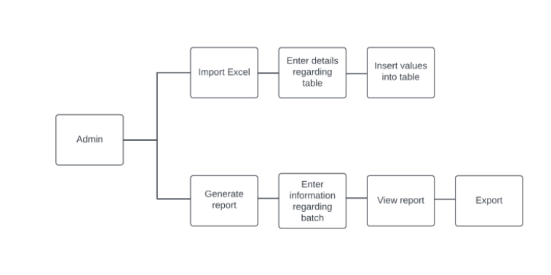
System Architecture Diagram

Slide 24
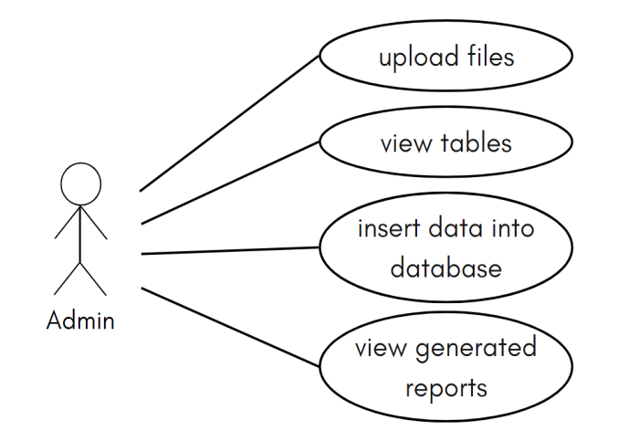
Use case diagram

Slide 25
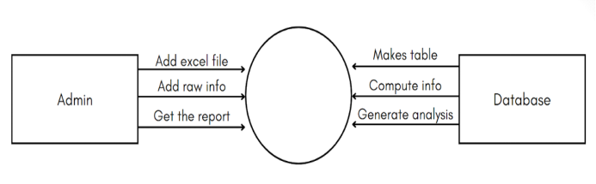
Data Flow diagram Level-0

Slide 26
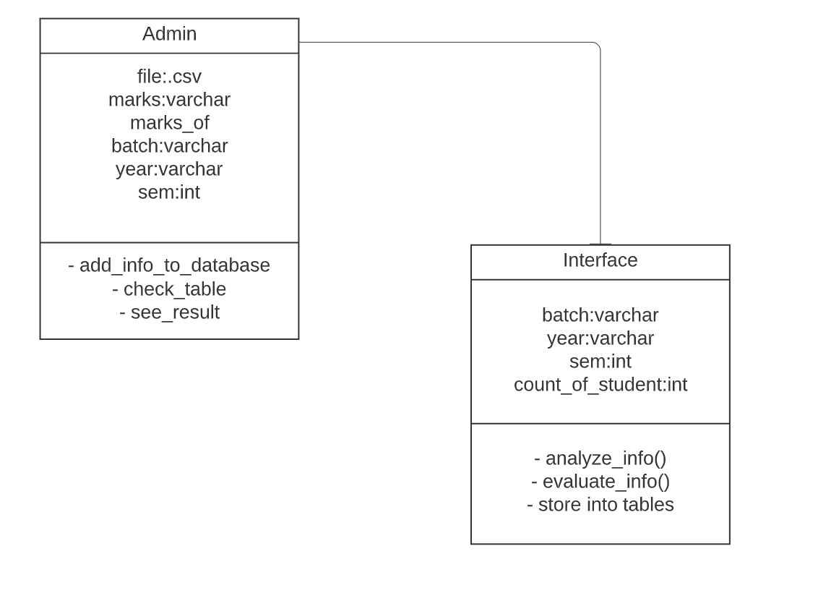
Class Diagram

Slide 27
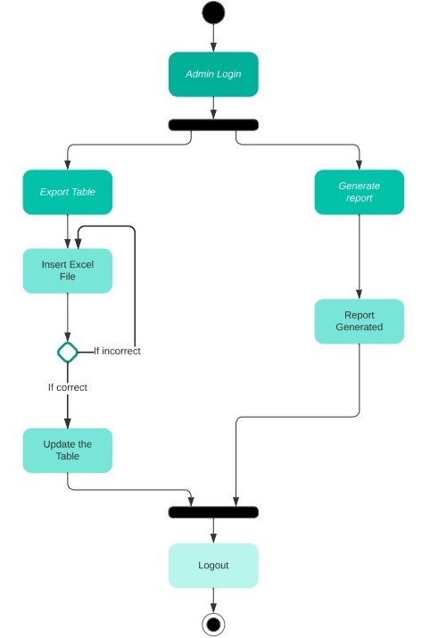
Activity Diagram

Slide 28
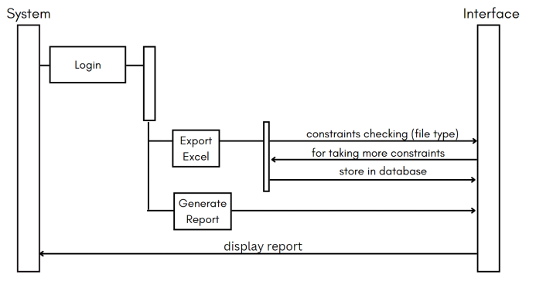
Sequence Diagram

Slide 29
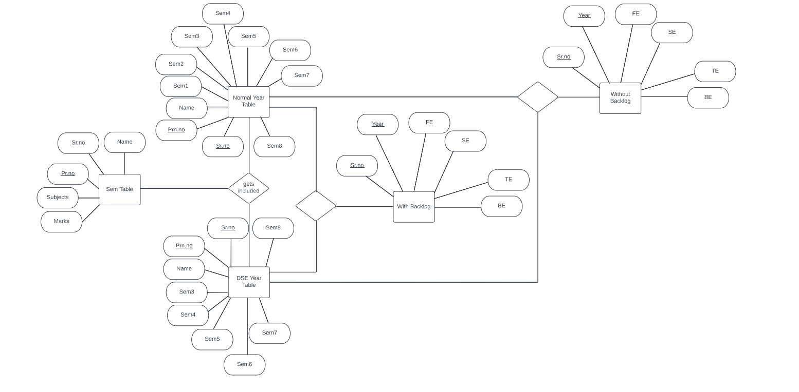
ER Model/Diagram

Slide 30
Pseudocode for each module
1. The user can generate report or add excel files into database
2. If Excel file is uploaded
Check if it is valid:
If valid:
Take batch and semester number as input
Take rows and column number to read
3. Then read file and display the data into table,
If reader selects to insert table:
Use year, batch and semester input to create tables:
If it is for fe:
Then also create a full table having all sem numbers as table columns
Else-if (for SE)
Check the names against full-table names to construct a full table consisting of only DSE students for respective batch.
Else:
Create separate tables and also append the sem info in the respective full table.(Normal or DSE).

Slide 31
Pseudocode for each module
If the most recent added semester is of even number (2,4,6,8):
• Check for the preceding table, if it exist, then
(1) count for prn no having all the semesters columns as as P
(2) do the same for kt prn no.
(3) Append the count into with_kt and without_kt tables.
(4) Also count all the rows and append that as intake.
• Retrieve information from with_kt and without_kt table and display as report.

Slide 32
Test cases for each module to check the validity
Test case no. | Description | Input | Result
1 | Login: The user must be allowed to access only if the credentials matches. | Email : amirashaikh2406@slrtce.in | Pass
Test case no. | Description | Input | Result
2 | Make tables when new excel sheet is uploaded as per rows and columns specified | Column selected: 2,3,5 Rows selected: 2 to 5 | Information read correctly
Test case no. | Description | Input | Result
3 | Analyze only when tables of both sems are available | - | Pass
Test case no. | Description | Input | Result
4 | Update information of the concerned row only | Year: SE, Batch: 2017-18, Sem: 4 Add to main table | Pass

Slide 33
Implementation plan in the form of Gantt
Milestones | Week 1 |  |  |  | Week 2 |  |  |  | Week 3 |  |  |  | Week 4 |  |  |  | Week 5 |  |  |  | Week 6
 | GL | GM1 | GM2 | GM3 | GL | GM1 | GM2 | GM3 | GL | GM1 | GM2 | GM3 | GL | GM1 | GM2 | GM3 | GL | GM1 | GM2 | GM3 | GL | GM1 | GM2 | GM3
Problem Statement
Project Objectives
Methodology
Literature Survey
Identification of essential concepts
Role of Technology
Requirement Collection
Software Requirement Specification
Project Scheduling & Distribution
High Level Design
Identifying the modules and test cases for each module
Low level design
Coding of the modules and debugging
Integration modules
Testing
Quality and accuracy of Software System
Demonstration of software system

Slide 34
Implementation plan in the form of Gantt
Milestones | Week 7 |  |  |  | Week 8 |  |  |  | Week 9 |  |  |  | Week 10 |  |  |  | Week 11 |  |  |  | Week 12
 | GL | GM1 | GM2 | GM3 | GL | GM1 | GM2 | GM3 | GL | GM1 | GM2 | GM3 | GL | GM1 | GM2 | GM3 | GL | GM1 | GM2 | GM3 | GL | GM1 | GM2 | GM3
Problem Statement
Project Objectives
Methodology
Literature Survey
Identification of essential concepts
Role of Technology
Requirement Collection
Software Requirement Specification
Project Scheduling & Distribution
High Level Design
Identifying the modules and test cases for each module
Low level design
Coding of the modules and debugging
Integration modules
Testing
Quality and accuracy of Software System
Demonstration of software system

Slide 35
Implementation plan in the form of Gantt
Milestones | Week 13 |  |  |  | Week 14 |  |  |  | Week 15 |  |  |  | Week 16 |  |  |  | Week 17 |  |  |  | Week 18
 | GL | GM1 | GM2 | GM3 | GL | GM1 | GM2 | GM3 | GL | GM1 | GM2 | GM3 | GL | GM1 | GM2 | GM3 | GL | GM1 | GM2 | GM3 | GL | GM1 | GM2 | GM3
Problem Statement
Project Objectives
Methodology
Literature Survey
Identification of essential concepts
Role of Technology
Requirement Collection
Software Requirement Specification
Project Scheduling & Distribution
High Level Design
Identifying the modules and test cases for each module
Low level design
Coding of the modules and debugging
Integration modules
Testing
Quality and accuracy of Software System
Demonstration of software system

Slide 36
Conclusion
Automating college systems are promising for the improvement of the accuracy of the information generated by the administrative staff and inculcates an efficient working environment.
Students Performance system will be very efficient for maintaining student database in one platform.
It will ease the work of producing student grades report and prevent error generation.
It will allow the teachers to use the students database in a efficient manner without going through redundant work with excel sheets.
It is truly a great opportunity for us to work on this project and contribute towards the development
of our institute.
It will capture important parameters and use it to produce criteria 4 for NBA accreditation.
Further this project will also consist of the placement’s information of the students. Remuneration Module will store most important professor remuneration details and use them accordingly. This system will consist of database that can be used not only for the proposed functions but also for the future functions.

Slide 37
Table showing achieved project objectives till date
Sr no. | Objectives | Remark
1 | Topic Research | Completed
2 | Technology selection | Completed
3 | Existing system review | Completed
4 | System Architecture | Completed
5 | Relational Database design | Completed
6 | Front-end design | Completed
7 | Division into modules | Completed
8 | Back-end of the modules and unit testing | Completed
9 | Integration testing | Completed
10 | Full system testing and debugging | Completed

Slide 38
Table showing Project outcomes attainment levels of Project Group member
COs | Statement | Mapped POs | Mapped Bloom Levels | Achieved attainment level 3- Excellence, 2- Good, 1-Fair
 |  |  |  | GL | GM1 | GM2 | GM3
CO1 | Able to - Apply engineering Knowledge and skill to solve Societal /Research /Innovation /Entrepreneurship problems in a group. (PO-1) | PO1 | L1, L2, L3 | 3 | 3 | 3 | 3
CO2 | Able to - Identify societal/research/innovation/entrepreneurship problems through appropriate literature surveys then evaluate problem statements and identifies objectives, processes/ modules/ algorithms/ existing solutions /alternate solutions /methods to solve the problem with best methods and processes. (PO-2) | PO2 | L4, L4 | 3 | 2 | 2 | 2
CO3 | Able to - Review state-of-the-art literature and synthesize/develop system requirements, specifications, design constraints, from larger social and professional concerns. (PO-3) | PO3 | L4, L5, L6 | 3 | 2 | 2 | 2
CO4 | Able to - Validate, Verify the results using test cases/benchmark data/ theoretical /inferences /experiments /simulations.(PO-4) | PO4 | L5 | 3 | 2 | 2 | 2
CO5 | Able to - Identify/use/create/modify/extend modern engineering tools, techniques and resources required for solution implementation. (PO-5) | PO5 | L4, L5, L6 | 3 | 3 | 3 | 2
CO6 | Able to - Use standard norms of engineering practices and understand ethics and misconduct of publication. (PO-6 and 8) | PO6, PO8 | L3, L4 | 3 | 3 | 3 | 3
CO7 | Able to - Analyze the impact of solutions in a societal and environmental context for sustainable development. (PO-7) | PO7 | L4, L5 | 3 | 2 | 3 | 2
CO8 | Able to - Develop interpersonal skills to work as a member of a group or leader. (PO-9) | PO9 | L1, L2, L3 |  | 2 | 3 | 3
CO9 | Able to - Communicate through technical report writing and oral presentation as per engineering standards. (PO-10) | PO10 | L1, L2, L3 | 3 | 2 | 2 | 2
 | The work may result in research/white paper/ article/blog writing and publication by understanding ethics and misconduct of publication. |  |  | 3 | 3 | 2 | 3
 | The work may result in a business plan for entrepreneurship products created. |  |  | 3 | 2 | 2 | 2
 | The work may result in the patent filing. |  |  | 3 | 2 | 3 | 2
CO10 | Able to - Demonstrate project management principles and financial considerations during project work. (PO-11) | PO11 | L3, L4, L5 | 3 | 2 | 2 | 3
CO11 | Able to - Demonstrate the capabilities of self-learning in a group, which leads to lifelong learning. (PO-12) | PO12 | L1-L6 | 3 | 3 | 2 | 3

Slide 39


